Slide 1



Bank of Baroda Hackathon - 2022
Technology Partner
Your Team Name : GOLDFOX
Your team bio : Alone we can do so little, Together we can do so much
Date :20-09-2022

Slide 2
Problem Statement?
Why did you decide to solve this Problem statement?
Bank cheques (checks) are still widely used all over the world for financial transactions. Huge volumes of handwritten bank cheques are processed manually every day in developing countries. In such a manual verification, user written information including date, signature, legal and courtesy amounts present on each cheque has to be visually verified. So we decided to come up with a solution in order to overcome these challenges. We can overcome these challenges by decreasing the usage of manual steps that require high human capital deployment and longer processing time. The technology which we have used in this project helps us to sort and identify the above mentioned problems.

Slide 3
Any Supporting Functional Documents
Present your solution, talk about methodology, architecture & scalability
As many countries use cheque truncation systems (CTS) nowadays, much time, effort and money can be saved if this entire process of recognition, verification and data entry is done automatically using images of cheques. We chose automated cheque processing as problem statement inorder to decrease the usage of manual steps that require human intervention to complete the process and reduce the processing time.
The high automation MPS intellivector automatically sorts and identifies cheque images by type , recogonizes their layout and locates data that require extraction and processing. The built in recogintion engines ( some of the best OCR and ICR engines available on the market) can recognize all the fields on a cheque including the handwritten ones. This automated cheque processing support multilingual and takes care of automated data entry and signature verification too.
The solution can easily be integrated with popular ECM systems and databases using built-in, ready-to-use system connectors. This means, it can be deployed in any heterogeneous IT environment while the results of the processing can be directly exported into the necessary enterprise system or database.
MPS IntelliVector combines automated processing (OCR and ICR) with microtasking and enterprise crowdsourcing to yield benefits of both – automated and human processing.

Slide 4
User Segment & Pain Points
Which user /advertiser segment would be early adopter of your product & why?
The MPS Intellivector’s microtasking approach guarantees that users involved in data validation or quality control have no access to the original data and work only with small pieces of anonymous data which contain no personally identifiable information. This way the original cheque images containing the confidential information never leave the customer site during the processing. The automated cheque processing solution based on MPS IntelliVector is perfectly suited for large scale cheque processing projects. Not only does it take less than 1 second to read an entire cheque, but the solution itself is highly scalable and is capable to process up to 1 million cheques per day.

Slide 5
Key Differentiators & Adoption Plan
How is your solution better than alternatives and how do you plan to build adoption?
High Accuracy and Reliable Data -The combination of automated recognition, machine learning, powerful validation logic and the microtask-based human validation for exception handling, ensures that only high accuracy results are forwarded to the appropriate LOB or enterprise systems.
Integration with Business Systems
Simple, Rapid Deployment at Reduced Cost - It offers simple, rapid deployment of AP automation solution. Document templates (including future templates) can be added on-the-fly, once the system is already live. This can be done by business users, without any IT or vendor involvement.
MPS IntelliVector combines automated processing (OCR and ICR) with microtasking and enterprise crowdsourcing to yield benefits of both – automated and human processing. In one hand –it maximizes the level of automation which reduces the need for manual processing and on other hand microtasking optimizes manual processing
Our solution extracts content from the handwritten text on cheque. It also converts the text of other languages to English and allows the user to make changes if required
All these above mentioned features enables our model to stand out from the rest.Our solution can provide a good and easy to use user interface(UI) for the bank to automate the processing of cheques which is way better than existing scenario of manual cheque processing

Slide 6
Pre-Requisite
What are the alternatives/competitive products for the problem you are solving?
There are automated systems which extract relevant details of a bank cheque like Payee Name, Amount, Date, Bank Name using Optical Character Recognition and Deep Learning and verify the signature on the cheque with the existing signature stored in the database using feature extraction and principal component analysis. In general use of a modified convolution neural network is used to extract the handwritten content on cheque leaf wherein The IAM data set referred above is used as an alternative and get the optimized results .

Slide 7
Azure tools or resources
Azure tools or resources which are likely to be used by you for the prototype, if your idea gets selected We are planning to use ->Microsoft Azure -Computer Vision ->Microsoft Azure -Natural Language ->Azure Form Recogniser ->and few other tools like Microsoft , visual studio code and translator

Slide 8
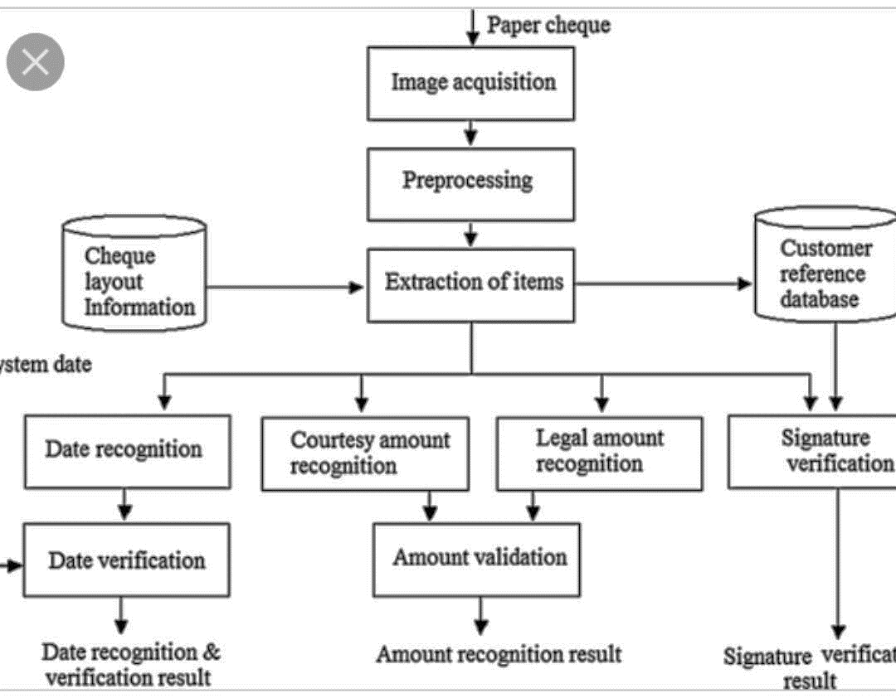







GitHub Repository Link & supporting diagrams, screenshots, if any
The below diagram is an idea of how our solution is going to be carried out throughout

Slide 9
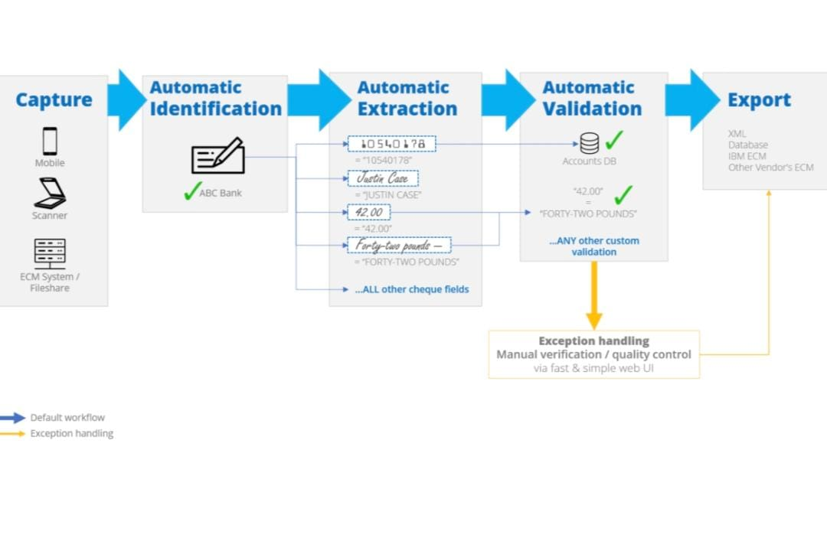

Slide 10
TECHGIG
Team member names
Adhithya G
Akash R
Ganesh S
Charithra E
THANK YOU

